Slide 1
Chapter 3 LEXICAL ANALYSIS
CSc 453: Lexical Analysis
1

Slide 2
Overview
tokens
source
program
lexical analyzer
(scanner)
syntax analyzer
(parser)
symbol table
manager
Main task: to read input characters and group them into “tokens.”
Secondary tasks:
  Skip comments and whitespace;
  Correlate error messages with source program (e.g., line number of error).
CSc 453: Lexical Analysis

Slide 3
Overview (cont’d)
Token
sequence
Input file
keywd_int
identifier: “main”
left_paren
keywod_int
identifier: “argc”
comma
keywd_char
star
star
identifier: “argv”
right_paren
left_brace
keywd_int
…
/ | * | p | g | m | . | c | * | / | \n | i | n
t |  | m | a | i | n | ( | i | n | t |  | a
r | g | c | , | c | h | a | r | * | * | a | r
g | v | ) | { | \n | \t | i | n | t |  | x | ,
Y | ; | \n | \t | f | l | o | a | t |  | w | ;
lexical
analyzer
. . .
CSc 453: Lexical Analysis

Slide 4
Implementing Lexical Analyzers
Different approaches:
  Using a scanner generator, e.g., lex or flex. This automatically generates a lexical analyzer from a high-level description of the tokens.
  (easiest to implement; least efficient)
  Programming it in a language such as C, using the I/O facilities of the language.
  (intermediate in ease, efficiency)
  Writing it in assembly language and explicitly managing the input.
  (hardest to implement, but most efficient)
CSc 453: Lexical Analysis

Slide 5
Lexical Analysis: Terminology
token: a name for a set of input strings with related structure.
Example: “identifier,” “integer constant”
pattern: a rule describing the set of strings associated with a token.
Example: “a letter followed by zero or more letters, digits, or underscores.”
lexeme: the actual input string that matches a pattern.
Example: count
CSc 453: Lexical Analysis

Slide 6
Examples
Input: count = 123
Tokens:
  identifier : Rule: “letter followed by …”
    Lexeme: count
  assg_op : Rule: =
  Lexeme: =
  integer_const : Rule: “digit followed by …”
  Lexeme: 123
CSc 453: Lexical Analysis

Slide 7
Attributes for Tokens
If more than one lexeme can match the pattern for a token, the scanner must indicate the actual lexeme that matched.
This information is given using an attribute associated with the token.
  Example: The program statement
    count = 123
  yields the following token-attribute pairs:
    ⟨identifier, pointer to the string “count”⟩
    ⟨assg_op, ⟩
    ⟨integer_const, the integer value 123⟩
CSc 453: Lexical Analysis

Slide 8
Specifying Tokens: regular expressions
Terminology:
  alphabet : a finite set of symbols
  string : a finite sequence of alphabet symbols
  language : a (finite or infinite) set of strings.
Regular Operations on languages:
  Union: R ∪ S = { x | x ∈ R or x ∈ S}
  Concatenation: RS = { xy | x ∈ R and y ∈ S}
  Kleene closure: R* = R concatenated with itself 0 or more times
  = {ε} ∪ R ∪ RR ∪ RRR ∪
  = strings obtained by concatenating a finite
  number of strings from the set R.
CSc 453: Lexical Analysis

Slide 9
Regular Expressions
A pattern notation for describing certain kinds of sets over strings:
Given an alphabet Σ:
  ε is a regular exp. (denotes the language {ε})
  for each a ∈ Σ, a is a regular exp. (denotes the language {a})
  if r and s are regular exps. denoting L(r) and L(s) respectively, then so are:
    (r) | (s) ( denotes the language L(r) ∪ L(s) )
    (r)(s) ( denotes the language L(r)L(s) )
    (r)* ( denotes the language L(r)* )
CSc 453: Lexical Analysis

Slide 10
Common Extensions to r.e. Notation
One or more repetitions of r : r+
A range of characters : [a-zA-Z], [0-9]
An optional expression: r?
Any single character: .
Giving names to regular expressions, e.g.:
  letter = [a-zA-Z_]
  digit = 0 | 1 | 2 | 3 | 4 | 5 | 6 | 7 | 8 | 9
  ident = letter ( letter | digit )*
  Integer_const = digit+
CSc 453: Lexical Analysis

Slide 11
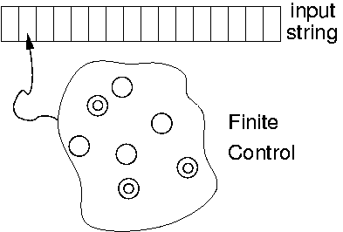
Recognizing Tokens: Finite Automata
A finite automaton is a 5-tuple (Q, Σ, T, q₀, F), where:
  Σ is a finite alphabet;
  Q is a finite set of states;
  T: Q × Σ → Q is the transition function;
  q₀ ∈ Q is the initial state; and
  F ⊆ Q is a set of final states.
CSc 453: Lexical Analysis

Slide 12
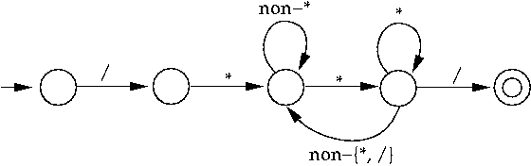
Finite Automata: An Example
A (deterministic) finite automaton (DFA) to match C-style comments:
CSc 453: Lexical Analysis

Slide 13
Formalizing Automata Behavior
To formalize automata behavior, we extend the transition function to deal with strings:
    Ŧ : Q × Σ* → Q
    Ŧ(q, ε) = q
    Ŧ(q, aw) = Ŧ(r, w) where r = T(q, a)
The language accepted by an automaton M is
    L(M) = { w | Ŧ(q₀, w) ∈ F }.
A language L is regular if it is accepted by some finite automaton.
CSc 453: Lexical Analysis

Slide 14
Finite Automata and Lexical Analysis
The tokens of a language are specified using regular expressions.
A scanner is a big DFA, essentially the “aggregate” of the automata for the individual tokens.
Issues:
  What does the scanner automaton look like?
  How much should we match? (When do we stop?)
  What do we do when a match is found?
  Buffer management (for efficiency reasons).
CSc 453: Lexical Analysis

Slide 15
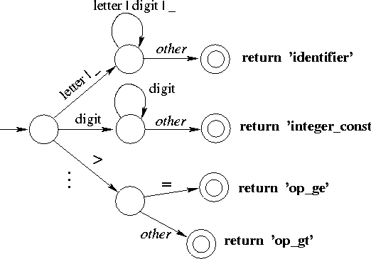
Structure of a Scanner Automaton
CSc 453: Lexical Analysis

Slide 16
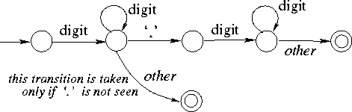
How much should we match?
In general, find the longest match possible.
E.g., on input 123.45, match this as
    num_const(123.45)
rather than
    num_const(123), “.”, num_const(45).
CSc 453: Lexical Analysis

Slide 17
Input Buffering
Scanner performance is crucial:
  This is the only part of the compiler that examines the entire input program one character at a time.
  Disk input can be slow.
  The scanner accounts for ~25-30% of total compile time.
We need lookahead to determine when a match has been found.
Scanners use double-buffering to minimize the overheads associated with this.
CSc 453: Lexical Analysis

Slide 18
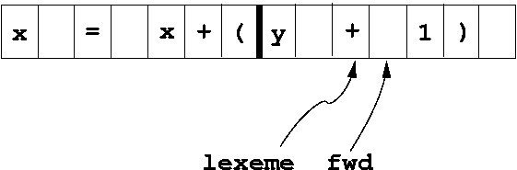
Buffer Pairs
Use two N-byte buffers (N = size of a disk block; typically, N = 1024 or 4096).
Read N bytes into one half of the buffer each time. If input has less than N bytes, put a special EOF marker in the buffer.
When one buffer has been processed, read N bytes into the other buffer (“circular buffers”).
CSc 453: Lexical Analysis

Slide 19
Buffer pairs (cont’d)
Code:
  if (fwd at end of first half)
    reload second half;
    set fwd to point to beginning of second half;
  else if (fwd at end of second half)
    reload first half;
    set fwd to point to beginning of first half;
  else
    fwd++;
  it takes two tests for each advance of the fwd pointer.
CSc 453: Lexical Analysis

Slide 20
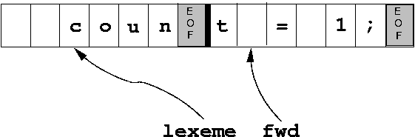
Buffer pairs: Sentinels
Objective: Optimize the common case by reducing the number of tests to one per advance of fwd.
Idea: Extend each buffer half to hold a sentinel at the end.
  This is a special character that cannot occur in a program (e.g., EOF).
  It signals the need for some special action (fill other buffer-half, or terminate processing).
CSc 453: Lexical Analysis

Slide 21
Buffer pairs with sentinels (cont’d)
Code:
  fwd++;
  if ( *fwd == EOF ) { /* special processing needed */
    if (fwd at end of first half)
      . . .
    else if (fwd at end of second half)
      . . .
    else /* end of input */
      terminate processing.
  }
  common case now needs just a single test per character.
CSc 453: Lexical Analysis

Slide 22
Handling Reserved Words
Hard-wire them directly into the scanner automaton:
  harder to modify;
  increases the size and complexity of the automaton;
  performance benefits unclear (fewer tests, but cache effects due to larger code size).
Fold them into “identifier” case, then look up a keyword table:
  simpler, smaller code;
  table lookup cost can be mitigated using perfect hashing.
CSc 453: Lexical Analysis

